Slide 1
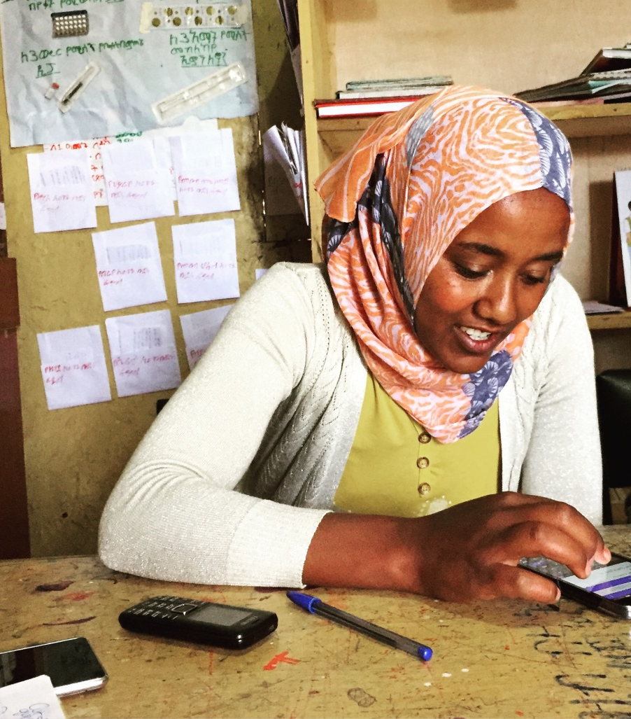
A Mobile Solution for Health Extension Workers in Ethiopia
Leona Rosenblum
June 21, 2018

Slide 2


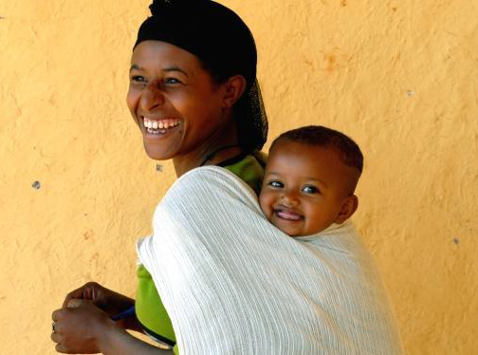
BACKGROUND + OBJECTIVES
Ethiopia’s Health Extension Worker Program
provides primary health care services to the community
Key Challenges
  Coverage
  Timeliness
  Quality
  Referral Linkages
Notes:
L10K 2020 is a four year project implemented by JSI Research & Training Institute, Inc (JSI) through funding from the Bill & Melinda Gates Foundation. L10K is supporting the Government of Ethiopia (GoE) in 115 rural districts of four of the most populous regions of the country (Amhara, Oromia, Southern Nations, Nationalities and Peoples’ [SNNP], and Tigray), to improve maternal and newborn health outcomes for a population of about 17 million.
Ethiopia's health system relies on Health Extension Workers (HEWs) to provide key RMNCH services to clients at Health Posts and directly at the household level. Under the L10K 2020 project, JSI is working with Dimagi to provide a mobile job aid for HEWs, Midwives, and HEW supporters to improve timeliness, coverage, and quality of RMNCH services and referrals.
Guiding questions:
What is the country/ project/ partner context for this intervention?
What is the health problem(s) the intervention aims to address?
What are the demographic and socioeconomic factors of the beneficiaries?
Who are the key stakeholders?

Slide 3
APPLICATION OVERVIEW
Release 1
-ANC 4+
-Delivery Referral
-PNC
-Newborn/PSBI
-PMTCT Indicator
-MDSR Indicator
Reporting/ Data Driven Management
HEW SERVICE DELIVERY WORKFLOW
Registration
HEW Client Interaction
Reminders/ Notifications
Appointment Management
Defaulter Tracking
Release 2
-Essential Nutrition
Actions
-EPI
-Notifiable Diseases
-Family Planning
HEW HEALTH SERVICE MODULES
Referrals to Health Center
Supervision for Improved Performance
Release 3
-CBNC
-ICCM
Notes:
Mobile Solution Consists of Three Interdependent Applications to Support HEWs:
Guiding questions:
What was the impetus to introduce technology?
Who are the providers/users of the platform?
Describe the application/ platform designed for this project.
What role did the users play in designing and using the ehealth system?
What was the approach to engaging stakeholders in the design phase? Which stakeholders were involved? Specifically address how government was involved in the design phase

Slide 4
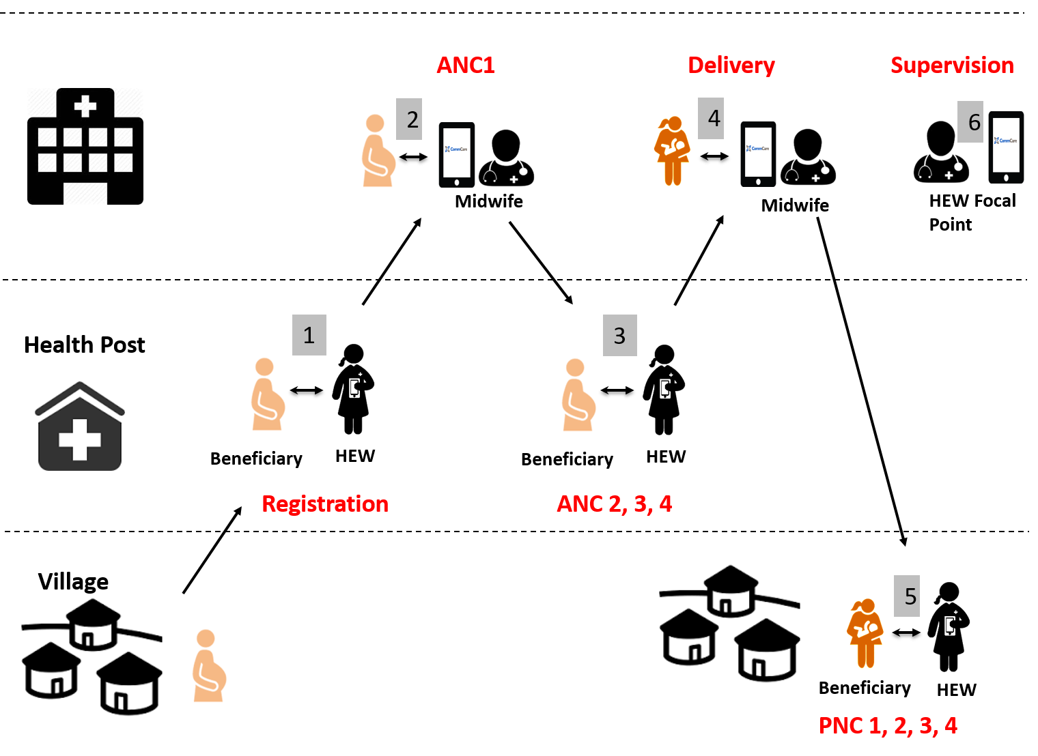
APPLICATION WORKFLOW
Notes:
Guiding questions:
What was the impetus to introduce technology?
Who are the providers/users of the platform?
Describe the application/ platform designed for this project.
What role did the users play in designing and using the ehealth system?
What was the approach to engaging stakeholders in the design phase? Which stakeholders were involved? Specifically address how government was involved in the design phase

Slide 5
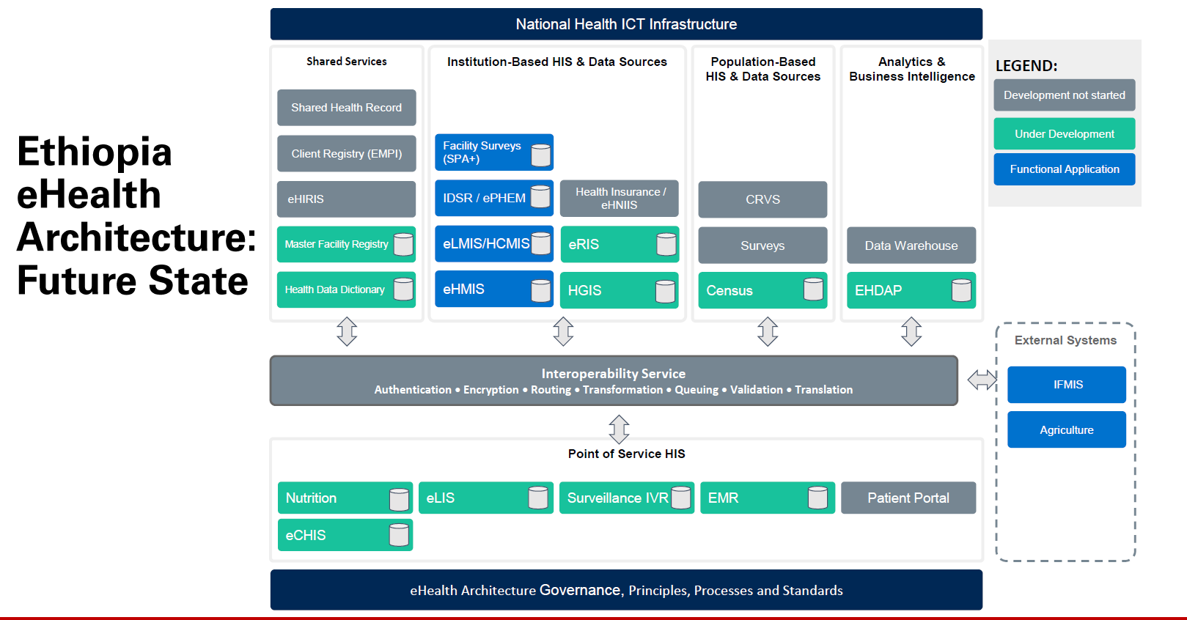
Notes:
Guiding questions:
How was the platform linked to the national information system (which systems specifically) and at what levels?
What were the key inputs – person time, expertise, cost that enabled this system to be initiated and scaled
What was the timeframe for rolling out the data platform from creating it, pilot-testing to training providers to use it and scaling? How long did it take? (Or how long is it projected to take?)

Slide 6

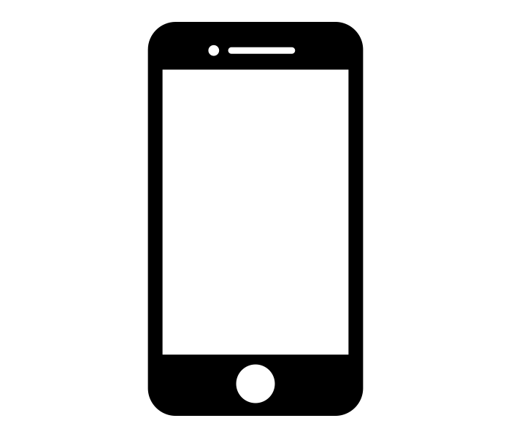
KEY SUCCESSES + LESSONS LEARNED
FMOH vision and decision making
Clearly defined goals & scope- improving service delivery through a mobile job aid at HEW level
User-centered process- iterative phased design is key
Users value application, particularly in faster and more complete information sharing between levels
Notes:
Guiding questions:
What have been the results: quantifiable (number of users, beneficiaries, etc) as well as qualitative, (reactions from end users, govt)
How have CHWs reacted to the ehealth system and how do they use the information they get from the system?
How do health managers use the data and how have they received the system?
What program changes, (if any), have been made based on use of the data?
What are the next steps – further scale, bring to new country, expand to new cadres or health areas, etc.
What key lessons were learned?
Since October 2017 the mobile application is being
implemented in four districts across four regions of the country covering about 400,000 people. About
162 HEWs used the app to provide maternal health services to 2,502 pregnant women. Between the
first and last quarters of the implementation period, the average number of pregnant women/HEW
recorded for: antenatal care increased from 2.4 to 6.6; receiving iron supplement increased from 2.6 to
5.7; institutional delivery increased from 4.4 to 7.7; postnatal care increased from 3.6 to 6. 7.

Slide 7
QUESTIONS + DISCUSSION

